Slide 1
Easy Transaction Database Project
Designed by
Group Members:
Md. Liakot Ali Liton, 1802035
Jannatul Ferdouse,1702010
Sonu Kumar Keshari,1802078
Umar Rabiu El-Yakub, 1802081
Presented to:
Md. Nahid Sultan
Assistant Professor,
Department of CSE,HSTU.

Slide 2
Content
Introduction
Inspiration
Features
Tools
Module Diagram
Use case Diagram
E-R Diagram
UI Design

Slide 3
Introduction
An app build to easy transactions between Customers and Shop owners
Objectives
General Objective:
To easy transaction between Shop owners and customer
Specific Objectives
To help save customers information and their transaction history
To know everything about your customers, in other to build trust between owners and customers
To implement the database knowledge we’re learning

Slide 4
Inspiration
Our main Inspiration came from how our society here is struggling with
maintaining the transaction their customers had with them especially in
the case of due so we decided to help our society build something
Features
Sign in feature for the Owner
Ability to add customers and their transaction
Ability to edit customers details and delete customer

Slide 5
Tools
Software
Android Studio
DB Browser for SQLite
Language
JAVA
Database
SQLite (Store data locally)
Firebase (To verify new user)

Slide 6
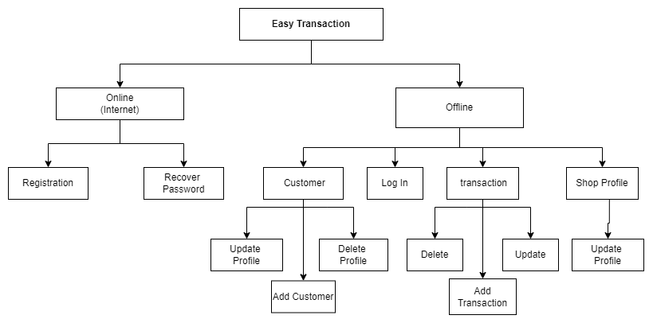
Module diagram

Slide 7
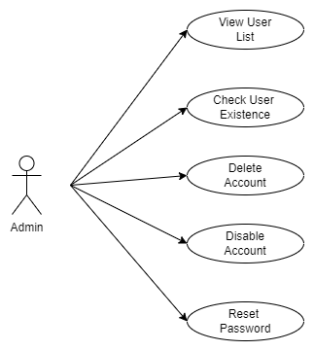
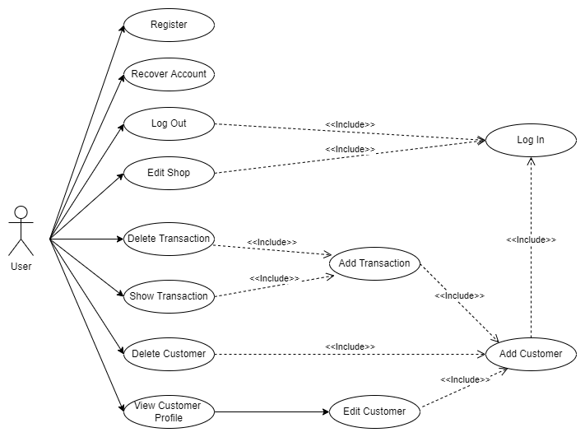
Use-Case diagram

Slide 8
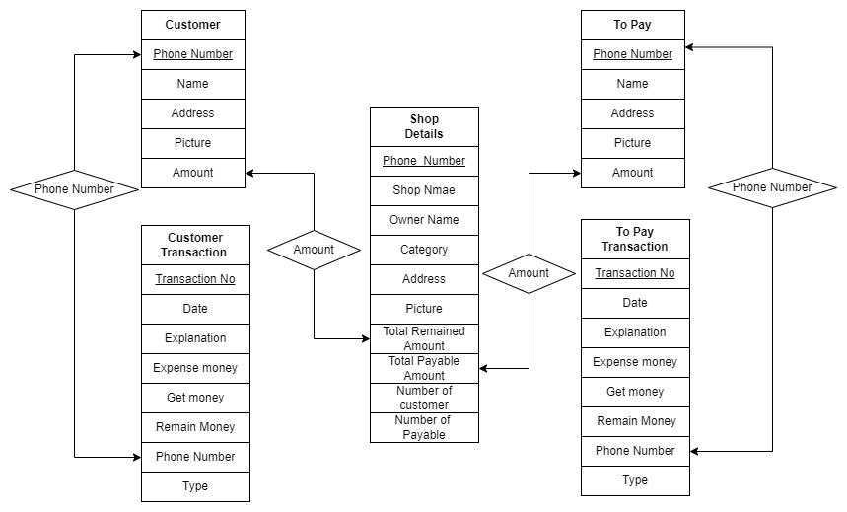
E-R diagram

Slide 9
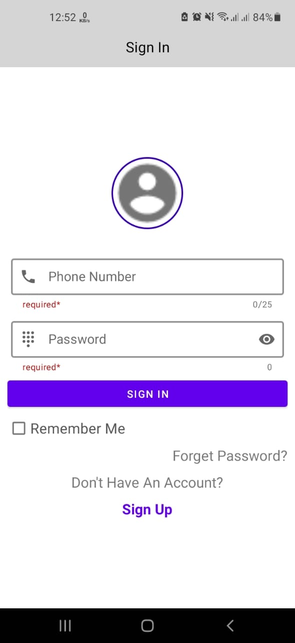
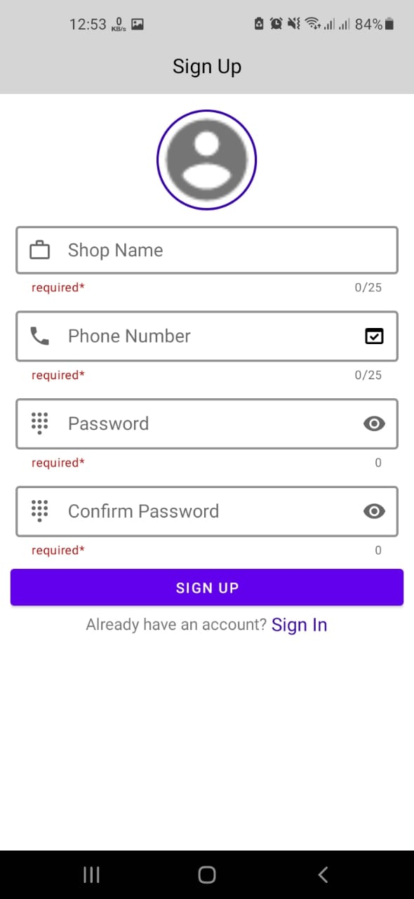
Sign in and Sign up page

Slide 10
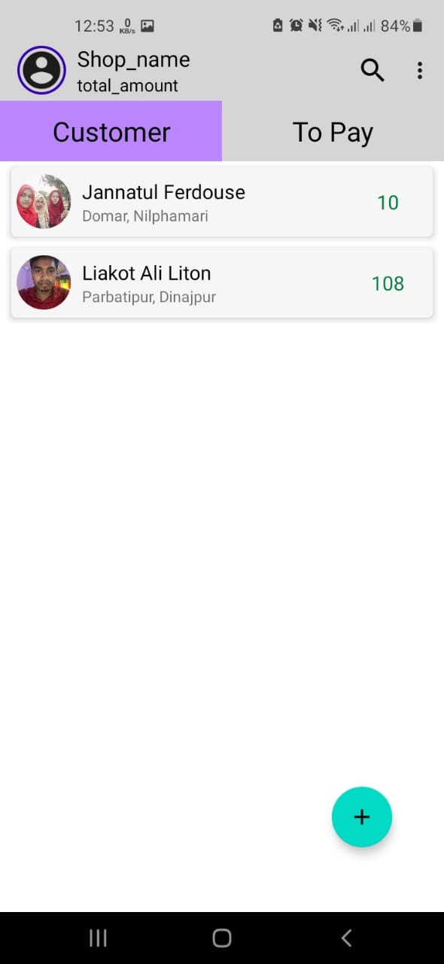
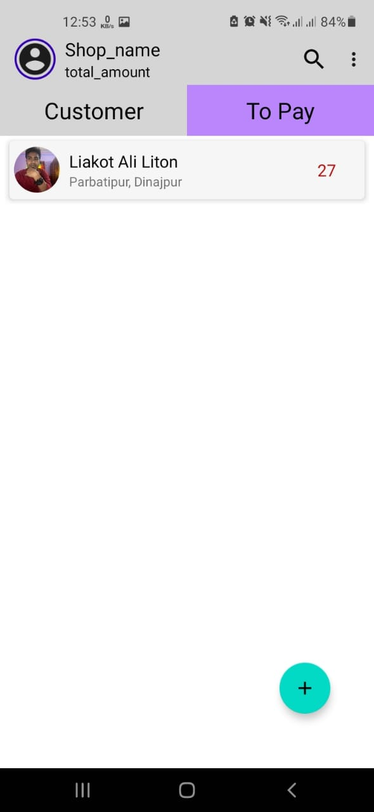
Home page

Slide 11
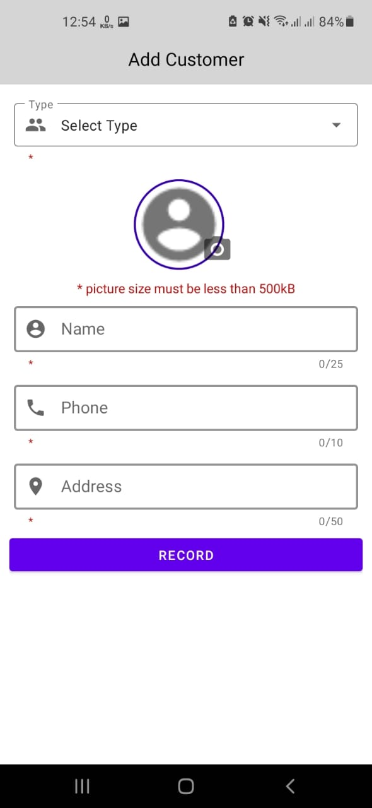
Add customer page

Slide 12
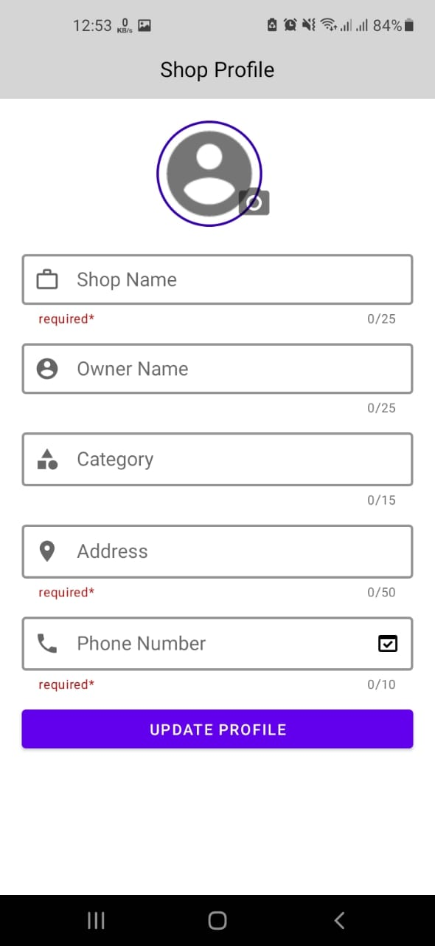
Shop profile

Slide 13
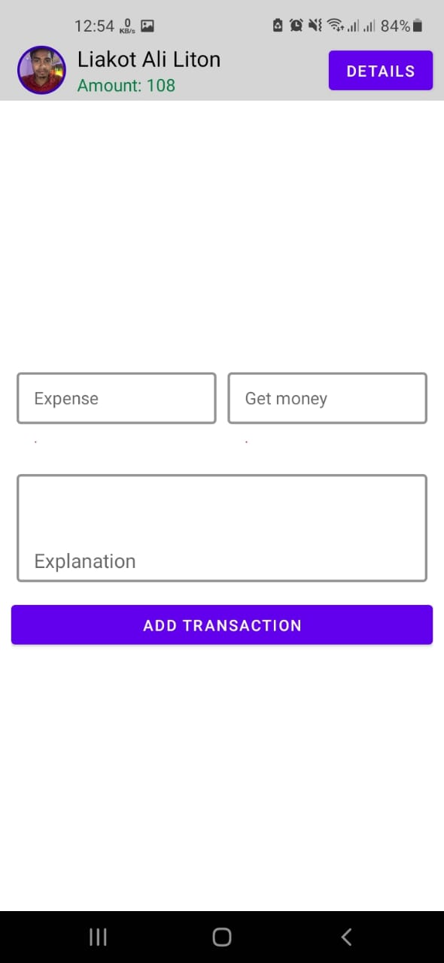
Add transaction

Slide 14
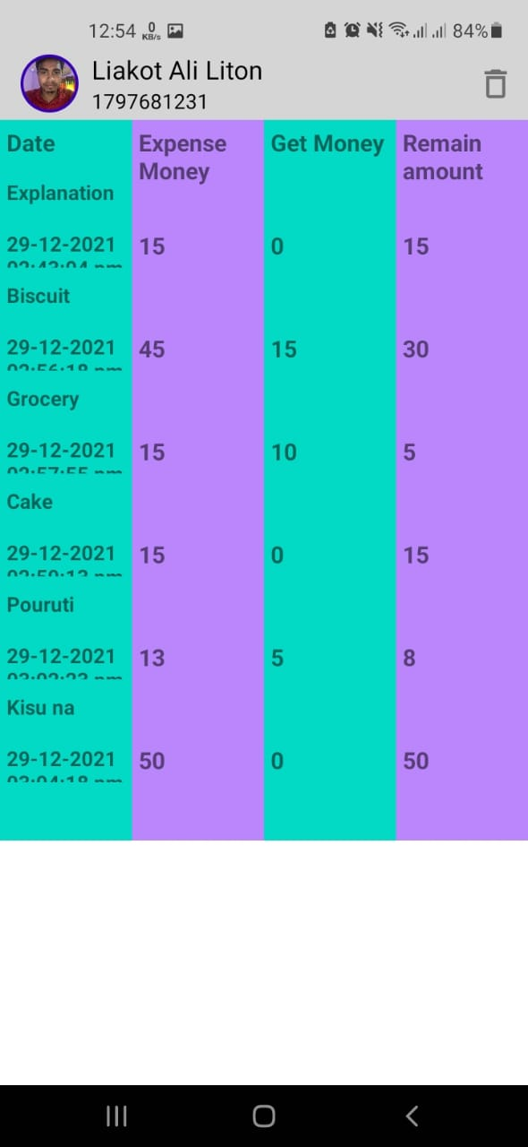
Transaction details

Slide 15
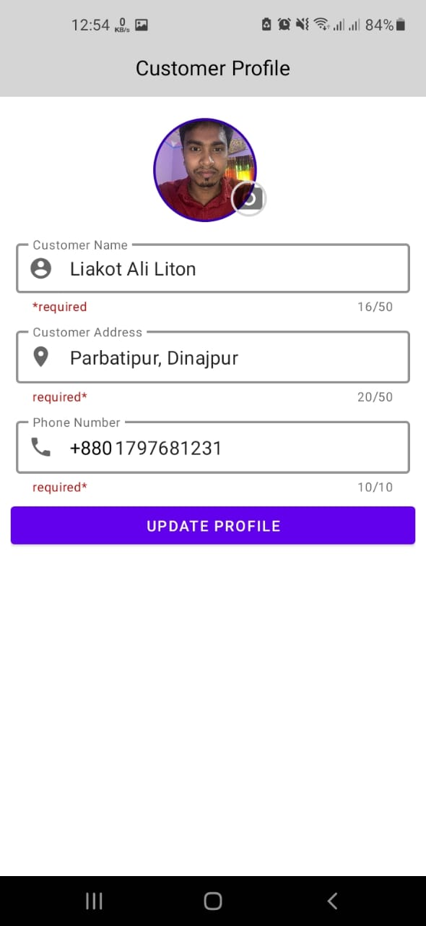
Customer profile

Slide 16
Thank You

